Slide 1
Sets & Set Operations
Lecture

Slide 2
Set
Definition 1
A set is an unordered collection of objects, called elements or members of the set. A set is said to contain its elements. We write a ∈ A to denote that a is an element of the set A. The notation a ∈ A denotes that a is not an element of the set A.
Number of objects in a set can be finite or infinite.
Example
a set of chairs
the set of integers
the set of natural numbers less than 10

Slide 3
Roster Method
One way of describing a set.
All members of the set are listed between curly braces, and separated by comma.
Example
The set V of all vowels in the English alphabet can be written as V = {a, e, i, o, u}.
The set O of odd positive integers less than 10 can be expressed by O = {1,3,5,7,9}.

Slide 4
Set Builder
Another way to describe a set.
Characterized all those elements in the set by stating the property or properties they must have to be members.
Example
The set O of all odd positive integers less than 10.
O = { x | x is an odd positive integer less than 10 }
or
O = { x ∈ Z⁺ | x is odd and x < 10 }

Slide 5
Important roles
N = { 0, 1, 2, 3,... }, the set of natural numbers
Z = { …, -2, -1, 0, 1, 2, … }, the set of integers Z⁺ = { 1, 2, 3, }, the set of positive integers
Q = { p/q | p ∈ Z, q ∈ Z, and q ≠ 0 }, the set of rational numbers
R the set of real numbers
R⁺ the set of positive real numbers C the set of complex numbers

Slide 6
Equality
Definition 2
Two sets are equal if and only if they have the same elements. Therefore, if A and B are sets, then A and B are equal if and only if ∀x ( x ∈ A ↔ x ∈ B ). We write A = B if A and B are equal sets.
Example
{ 1, 3, 5 } = { 3, 5, 1 } = { 1, 3, 3, 3, 5, 5, 5, 5, 5 }
Note:
It doesn’t matter if an element of a set is listed more than once as long as they have the same elements.

Slide 7
Special Sets
The universal set is denoted by U: the set of all objects under the consideration, represented by a rectangle.
The empty set is denoted as Ø or { }.
Cardinality
Definition 4
Let S be a set. It there are exactly n distinct elements in S where n is a nonnegative integer, we say that S is a finite set and that n is the cardinality of S. The cardinality of S is denoted by |S|.

Slide 8
Example
V = { 1, 2, 3, 4, 5 }
| V | = 5
A = { 1, 2, 3, 4, 5, … , 20 }
| A | = 20
| Ø | = 0

Slide 9
Infinite Set
Example
A set is infinite if it is not finite.
The set of natural numbers is an infinite set.
N = { 1, 2, 3, … }
The set of reals is an infinite set.
Power Set
Definition 6
Given a set S, the power set of S is the set of all subsets of the set S. The power set of S is denoted by P(S).
Solution
What is the power set of the set { 0, 1, 2 }?
The power set P({ 0, 1, 2 }) is the set of all subsets of { 0, 1, 2 }. Hence,
P({ 0, 1, 2 }) = { Ø, {0}, {1}, {2}, { 0, 1 }, { 0, 2 }, { 1, 2 }, { 0, 1, 2 }}

Slide 10
n-tuple
Definition 7
The ordered n-tuple ( a₁ ,a₂ , … , a_{n} ) is the ordered collection that has a₁ as its first element, a₂ as its second element, …, and a_{n} as its nth element.
Cartesian Product
Definition 8
Let S and T be sets. The Cartesian Product of A and B, denoted by A x B, is the set of all ordered pairs (a, b), where a ∈ A and b ∈ B. Hence,
A x B = { (a, b) | a ∈ A ꓥ b ∈ B }

Slide 11
Solution
What is the Cartesian Product of A = { 2, 5 } and B = { x, y, z }?
A x B = { (2, x), (2, y), (2, z), (5, x), (5, y), (5, z) }
B x A = { (x, 2), (y, 2), (z, 2), (x, 5), (y, 5), (z, 5) }
Note:
S x T ≠ T x S
Solution
A = { John, Peter, Mike }
B = { Jane, Ann, Laura }
A x B = { (John, Jane),(John, Ann) , (John, Laura), (Peter, Jane),
(Peter, Ann) , (Peter, Laura) , (Mike, Jane) , (Mike, Ann) , (Mike, Laura) }

Slide 12
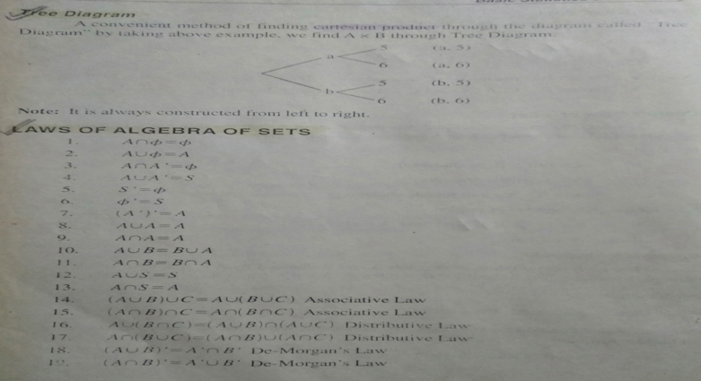
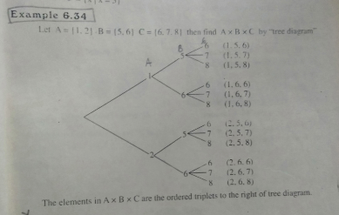
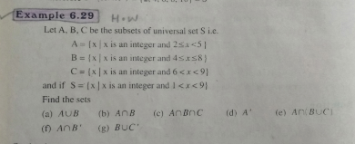

Slide 13
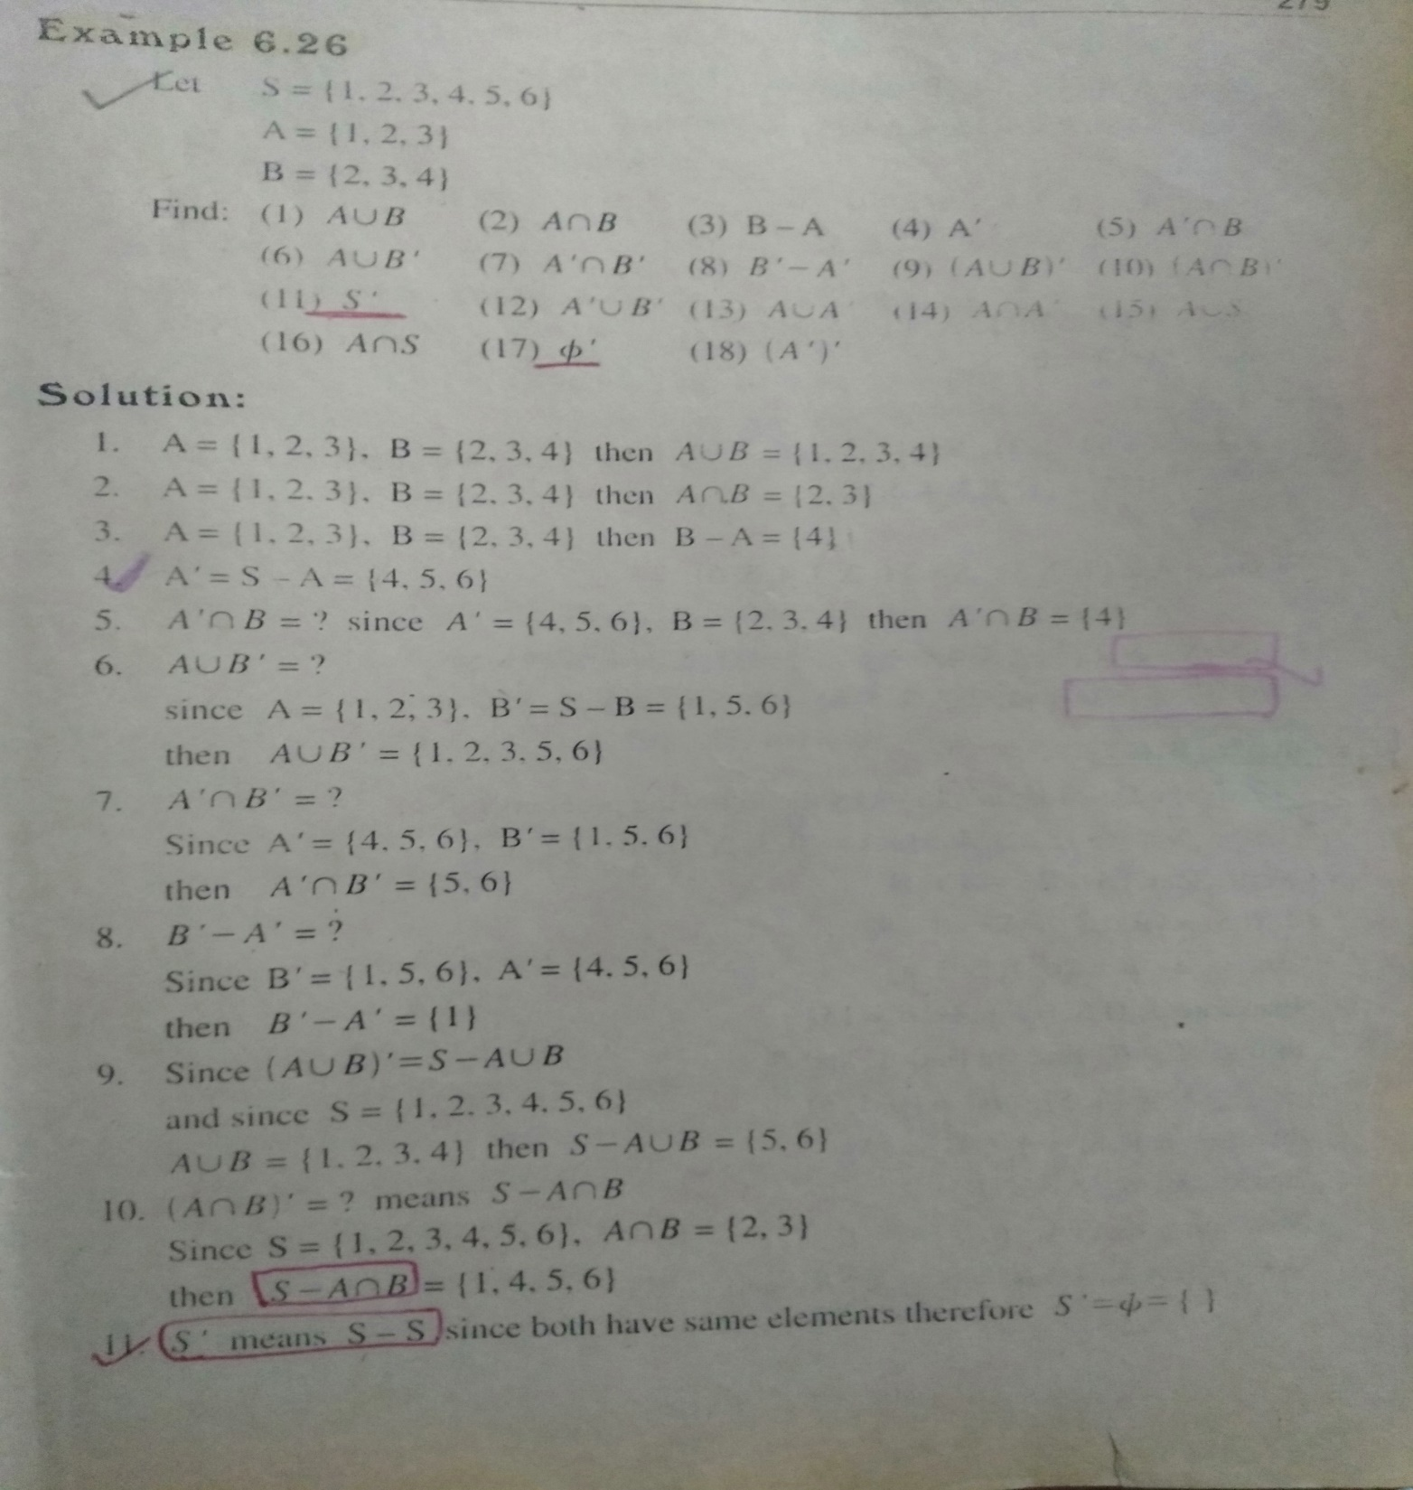
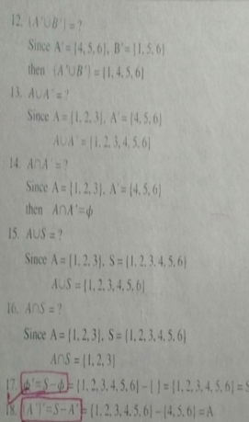

Slide 14
Set Operations

Slide 15
Union
Definition 1
Let A and B be sets. The union of the sets A and B, denoted by A U B, is the set that contains those elements that are either in A or B.
A = { a, b, c, d, o }
B = { a, e, i, o, u }
U
i
d
c
u
o
A U B = { a, b, c, d, e, i, o, u}
b
a
e
A
g
f B

Slide 16
Intersection
Let A and B be sets. The intersection of the sets A and B, denoted by A ∩ B, is the set that contains those elements in both A and B.
Solution
A = { a, b, c, d, o }
B = { a, e, i, o, u }
U
i
d
c
u
o
A ∩ B = { a, o }
b
a
e
A
g
f B

Slide 17
Disjoint Sets
Two sets are called disjoint if their intersection is the empty set.
Example
A = { b, c, d }
B = { a, e, o }
U
A
i
d
c
u
o
A ∩ B = { Ø }DISJOINT!
b
a
e
g
f
B

Slide 18
Set Difference
Let A and B be sets. The difference of the sets A and B, denoted by A – B, is the set that contains those elements that are in A but not in B. The difference of A and B is also called the compliment of B with respect to A.
Note: It is sometimes denoted by A\B
Example
A = { a, b, c, d, o }
B = { a, e, i, o, u }
U
i
d
c
u
o
A – B = { b, c, d }
b
a
e
A
g
f B

Slide 19
Compliment
Definition 5
Let U be the universal set. The compliment of the set A, denoted by Ā, is the compliment of A with respect to U. Therefore, the compliment of the set A is U – A.
Solution
Let A = { a, e, i, o, u }
where the universal set is the set of letters of the English Alphabet.
Ā = { b, c, d, f, g, h, j, k, l, m, n, p, q, r, s, t, v, w, x, y, z }

Slide 20
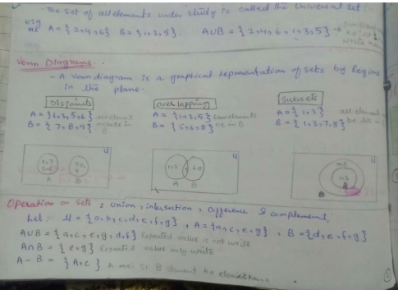

Slide 21
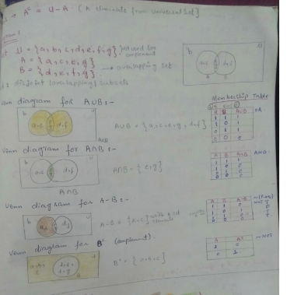

Slide 22
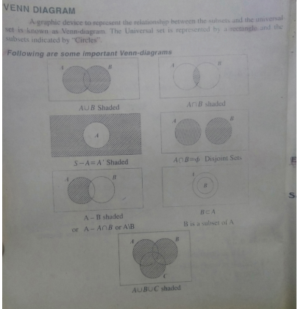
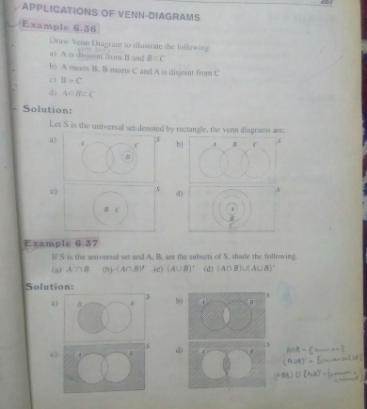

Slide 23
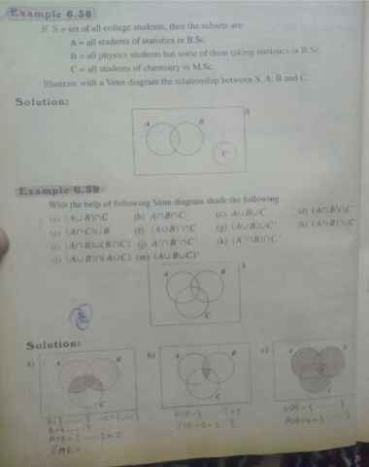
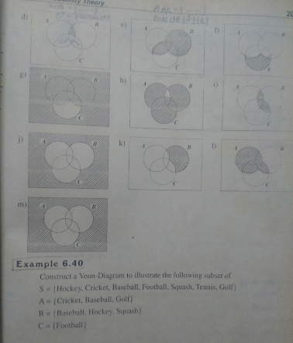

Slide 24
SEQUENCE:
A sequence is just a list of elements usually written in a row.
EXAMPLES:
1. 1, 2, 3, 4, 5, …
2. 4, 8, 12, 16, 20,…
3. 2, 4, 8, 16, 32, …
4. 1, 1/2, 1/3, 1/4, 1/5, …
5. 1, 4, 9, 16, 25, …
6. 1, -1, 1, -1, 1, -1, …
NOTE: The symbol “…” is called ellipsis, and reads “and so forth”
e.g # 2) 4,8,12,16,20
Image of (1)= 4
Image of (2)= 8
Image of (3)= 12
Image of (4)= 16
Image of (5)= 20
FORMAL DEFINITION:
A sequence is a function whose domain is the set of integers greater than or equal to a particular integer n0. Usually this set is the set of Natural numbers {1, 2, 3, …} or the set of whole numbers {0, 1, 2, 3, …}.
NOTATION:
We use the notation an to denote the image of the integer n, and call it a term of the sequence. Thus
a1, a2, a3, a4 …, an, …
represent the terms of a sequence defined on the set of natural numbers N.
Note that a sequence is described by listing the terms of the sequence in order of increasing subscripts.

Slide 25
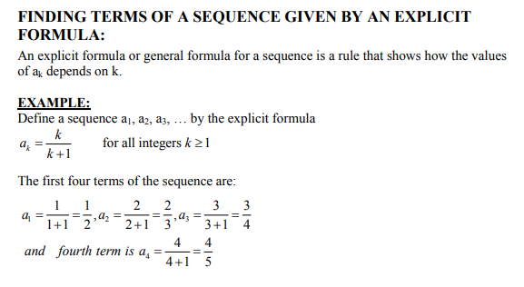
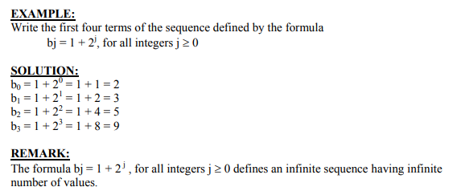

Slide 26
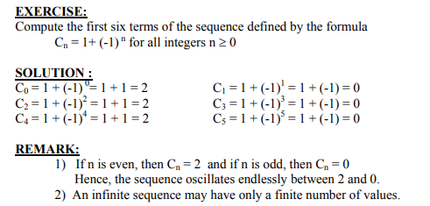
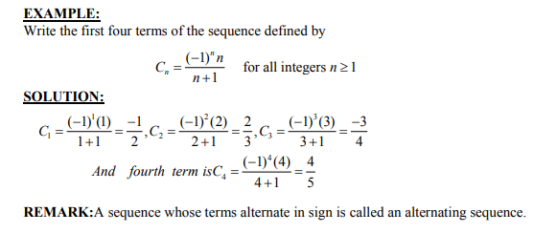

Slide 27
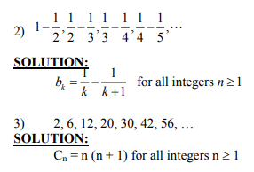
EXERCISE:
Find explicit formulas for sequences with the initial terms given:
1) 0, 1, -2, 3, -4, 5, …

Slide 28
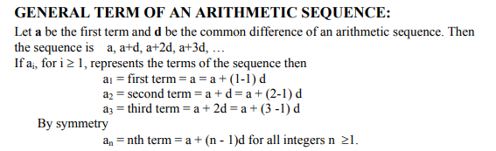
ARITHMETIC SEQUENCE:
A sequence in which every term after the first is obtained from the preceding term by adding a constant number is called an arithmetic sequence or arithmetic progression (A.P.)
The constant number, being the difference of any two consecutive terms is called the common difference of A.P., commonly denoted by “d”.
EXAMPLES:
1. 5, 9, 13, 17, … (common difference = 4)
2. 0, -5, -10, -15, … (common difference = -5)
3. x + a, x + 3a, x + 5a, … (common difference = 2a)

Slide 29
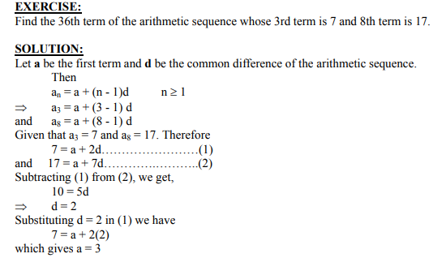
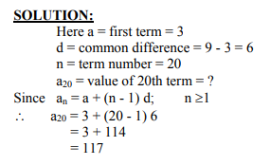
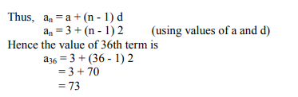
EXAMPLE:
Find the 20th term of the arithmetic sequence
3, 9, 15, 21, …

Slide 30
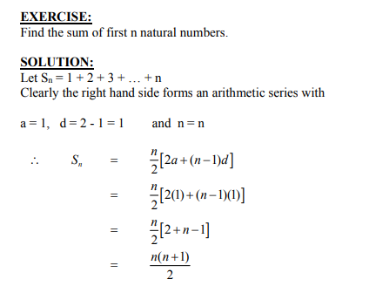
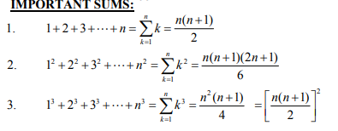

Slide 31
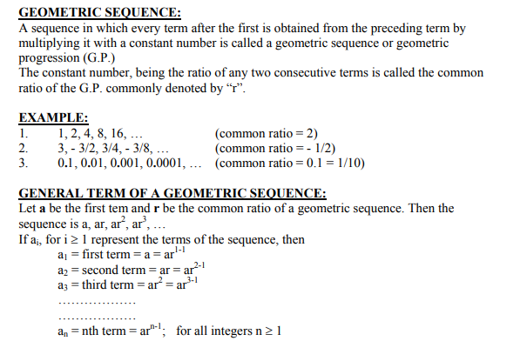

Slide 32
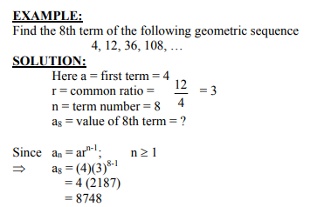
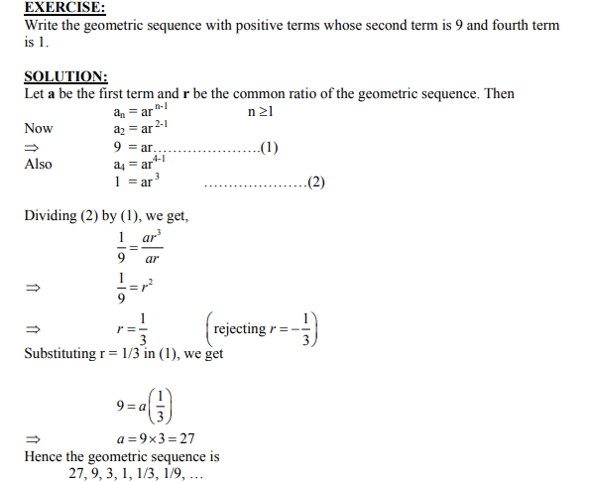

Slide 33
SEQUENCES IN COMPUTER PROGRAMMING:
An important data type in computer programming consists of finite sequences known as one-dimensional arrays; a single variable in which a sequence of variables may be stored.
EXAMPLE:
The names of k students in a class may be represented by an array of k elements “name” as:
name [0], name[1], name[2], …, name[k-1]

Slide 34
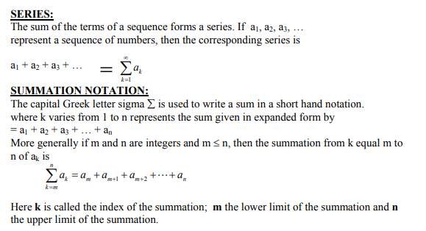

Slide 35
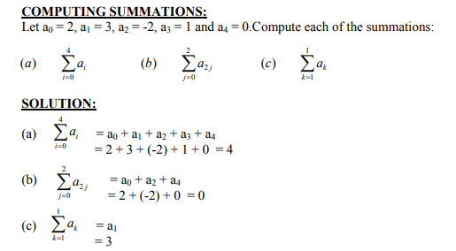

Slide 36
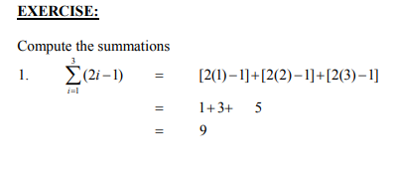
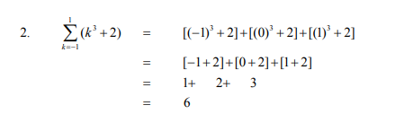

Slide 37
